Slide 1
Chapter 1 Instruction Set Architecture

Slide 2
Google Classroom code:
kzlxphr

Slide 3
Contents:
Computer Organization and Architecture
Levels of programming language
The compilation process
Instruction set architecture
Instruction and its elements
Operand datatypes
Instruction types
Instruction format
Addressing modes
Design issues of ISA

Slide 4
1.1 Computer Organization
Computer organization refers to the operational units and their interconnection to form the computer system that can perform as intended.
Computer organization refers to the way in which the hardware components of a computer system are arranged and interconnected to form a functional system.
It deals with the macro-level details of the system design, such as the way in which the CPU, memory, and I/O devices are connected to each other, the bus structure, and the memory hierarchy.
The goal of computer organization is to optimize the performance of a computer system by designing efficient hardware components and organizing them in an optimal way to minimize the overall system cost and maximize the system's processing speed, reliability, and scalability.
Organizational attributes include the hardware detail such as:
Control signal computer
Interfaces between the computer and peripherals
Memory technology used, etc

Slide 5
1.2 Computer Architecture
Computer architecture refers to those attributes of a system that have a direct impact on the logical execution of a program.
It is concerned with the structure and behavior of the computer as seen by the user, i.e. those attributes of a system visible to a programmer.
It deals with the structure of behavior of various functional modules and how they interact to provide the processing needs of the computer.
It includes:
The instruction set
The no. of bits used to represent various data types.
I/O mechanism
Memory addressing techniques

Slide 6
CO vs CA
The difference between architecture and organization is best described by a non-computer example.
Is the gear level in a motorcycle part of it is architecture or organization?
The architecture of a motorcycle is simple; it transports you from A to B.
The gear level belongs to the motorcycle’s organization because it implements the function of a motorcycle but is not part of that function.
We can take another example of multiplying two numbers.
Computer architecture defines whether direct multiplication instruction is used or multiply by repeated addition.
Whereas, computer organization defines whether multiplication unit is used or repeated addition by adder.

Slide 7
CO vs CA
Scope: Computer organization deals with the physical and logical arrangement of the hardware components of a computer system, while computer architecture deals with the design of those components and their interconnections.
Level of Detail: Computer organization deals with the lower-level details of a computer system, such as the way in which the CPU, memory, and I/O devices are connected to each other, the bus structure, and the memory hierarchy. Computer architecture deals with higher-level details, such as the design of the instruction set architecture (ISA), cache memory, and pipelining.
Focus: Computer organization focuses on the functional operation of a computer system, while computer architecture focuses on the performance and efficiency of the system.
Goal: The goal of computer organization is to optimize the functional operation of a computer system by designing efficient hardware components and organizing them in an optimal way. The goal of computer architecture is to design an efficient and scalable computer system that can meet the performance requirements of a wide range of applications.
Application: Computer organization is more applicable to specific systems, while computer architecture is applicable to a wide range of computer systems, from embedded systems to supercomputers.

Slide 8
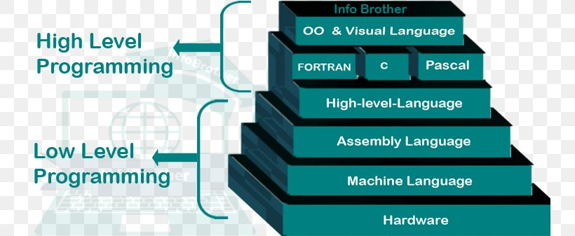
1.3 Levels of Programming language

Slide 9
1. Low-level language
Low-level language is a programming language in which each statement or instruction is directly translated into a single machine code.
LLL are much closer to the computer or hardware.
Before creating a program for hardware, it is required to have through or sound knowledge of that hardware.
A program cannot be run on different hardware, which means LLL are specific to the hardware.
LLL is also divided into two types:
Machine language
Assembly language

Slide 10
a) Machine language
Machine languages are the lowest level programming languages.
A computer understands the programs written only in the machine language.
While easily understood for humans to use, they consist entirely of numbers.
Ultimately, machine code consists entirely of 0’s and 1’s of the binary system which are also called bits.
The machine code may be different from machine to machine, i.e. they are hardware dependent.
Programs written in machine language are faster and efficient.
Writing programs in machine language is very tedious, time consuming, difficult to find bugs in longer programs.

Slide 11
Merits:
It is directly understood by the processor so has faster execution time since the programs written in this language need not to be translated.
It doesn’t need larger memory.
Demerits:
It is very difficult to program using 1GL since all the instructions are to be represented by 0s and 1s.
Use of this language makes programming time consuming.
It is difficult to find error and to debug.
It can be used by experts only.

Slide 12
b) Assembly language
To overcome the difficulties of programming in machine language, assembly languages were developed.
An assembly language contains the same instruction as a machine language.
But each instruction and variable have a symbol instead of being just numbers.
And these symbols are called ‘mnemonics’.
For e.g., if 78 is the number to command “Add two numbers”, ADD could be used to replace it.
After developing assembly language, it was easier to program using symbols instead of numbers.
But the programs written in assembly language, however, must be converted to machine language, which could be done by assembler.
They are also machine-dependent.

Slide 13
Merits:
It makes programming easier than 1GL since it uses mnemonics code for programming. Eg: ADD for addition, SUB for subtraction, DIV for division, etc.
It makes programming process faster.
Error can be identified much easily compared to 1GL.
It is easier to debug than machine language.
Demerits:
Programs written in this language is not directly understandable by computer so translators should be used.
It is hardware dependent language so programmers are forced to think in terms of computer’s architecture rather than to the problem being solved.
Being machine dependent language, programs written in this language are very less or not portable.
Programmers must know its mnemonics codes to perform any task.

Slide 14
2. High Level Language
The programming languages are called HLL if their syntax is closer to the human languages.
HLL were developed to make programs easier.
Most of the HLL are English-like language.
They use familiar English words, special symbols and mathematical symbols in their syntax.
Therefore, HLL are easier to read, write, understand and program.
Each HLL has their own set of grammar and rules to represent a set of instructions.
Programming languages such as C, C++, Java, etc. are some examples of HLL.
Like an assembly language programs, programs written in HLL also need to be translated into machine language.
This can be done either by a compiler or an interpreter.

Slide 15
Merits:
Because of their flexibility, procedural languages are able to solve a variety of problems.
Programmer does not need to think in term of computer architecture which makes them focused on the problem.
Programs written in this language are portable.
Demerits:
It is easier but needs higher processor and larger memory.
It needs to be translated therefore its execution time is more.

Slide 16
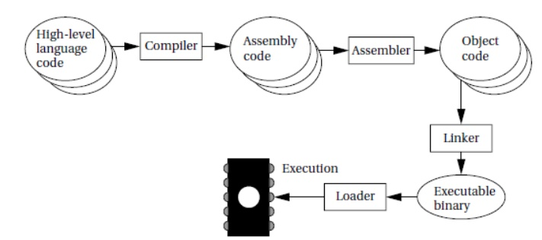
1.4 The Compilation process

Slide 17
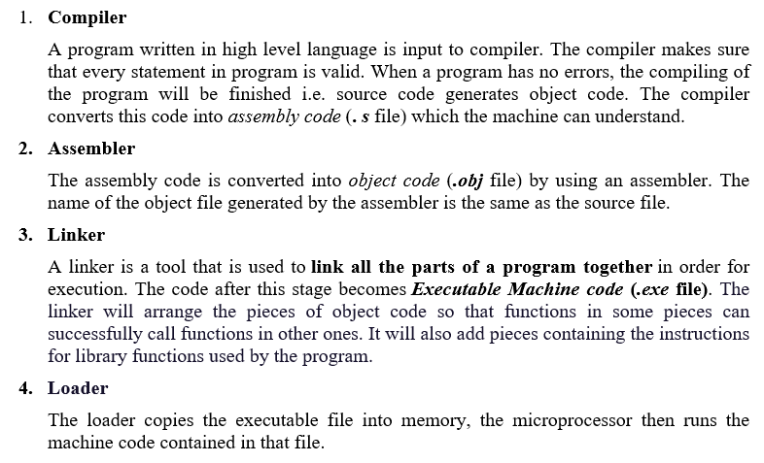

Slide 18
1.5 Instruction set Architecture (ISA)
Instruction Set Architecture (ISA) refers to the overall design of the instruction set, including the types of instructions available, the way they are encoded, and the underlying hardware that supports them.
The Instruction Set Architecture (ISA) is the part of the processor that is visible to the programmer or compiler designer.
They are the parts of a processor design that need to be understood in order to write assembly language, such as the machine language instructions and registers.
The ISA serves as the boundary between software and hardware.
The ISA defines
the supported data types,
the registers,
how the hardware manages main memory,
key features (such as virtual memory), which instructions a microprocessor can execute, and
the input/output model of multiple ISA implementations.

Slide 19
1.5 Instruction set Architecture (ISA)
Instruction Set Architecture (ISA) refers to the overall design of the instruction set, including the types of instructions available, the way they are encoded, and the underlying hardware that supports them.
Further study: https://www.learncomputerscienceonline.com/instruction-set-architecture/

Slide 20
Instruction Set
The collection of different instructions that the processor can execute is referred to as the processor’s instruction set.
The instruction format involves:
The instruction length,
the type;
length and position of operation codes in an instruction;
and the number and length of operand addresses, etc

Slide 21
1.6. Opcode and Operands
Opcode: (What operation to perform?)
An operation code field termed as opcode that specifies the operation to be performed.
Operands: (Where are the operands?)
An address field of operand on which data processing is to be performed.
An operand can reside in the memory or a processor register or can be incorporated within the operand field of instruction as an immediate constant.
Therefore, a mode field is needed that specifies the way the operand or its address is to be determined.
Eg: MOV A, B
Here MOV is opcode and A, B are operands

Slide 22

Elements of an instruction
Operation code: Specifies the operation to be performed (e.g., ADD, I/O). The operation is specified by a binary code, known as the operation code, or opcode.
Source operand reference: The operation may involve one or more source operands, that is, operands that are inputs for the operation.
Result operand reference: The operation may produce a result.
Next instruction reference: This tells the processor where to fetch the next instruction after the execution of this instruction is complete.
Figure: A Simple instruction format

Slide 23
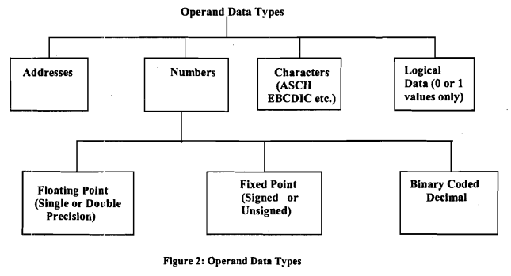
1.7. Operands data types

Slide 24
1.7. Operands data types (Contd.)
Address: Addresses provided in the instruction are operand references.
Numbers: All machine languages include numeric data types like floating-point numbers, fixed-point numbers, binary coded decimal numbers
Characters: A common form of data is text or character strings. Represented in ASCII, EBCDIC
Logical data: Normally, each word or other addressable unit (byte, halfword, and so on) is treated as a single unit of data.
EBCDIC: Extended Binary Coded Decimal Interchange Code
ASCII: or American Standard Code for Information Interchange.

Slide 25
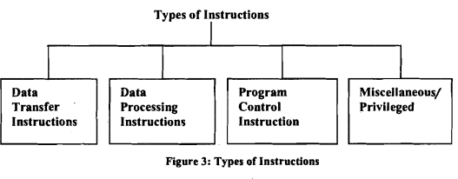
1.8 Instruction type

Slide 26
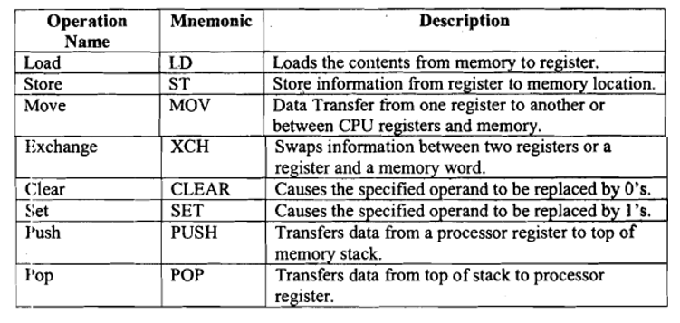
1. Data Transfer Instructions
These instructions transfer data from one location in the computer to another location without changing the data content.

Slide 27
2. Data Processing (or manipulation) instructions
These instructions perform arithmetic and logical operations on data.
Data manipulation Instructions can be divided into three basic types:
Arithmetic
Logical
Shift

Slide 28
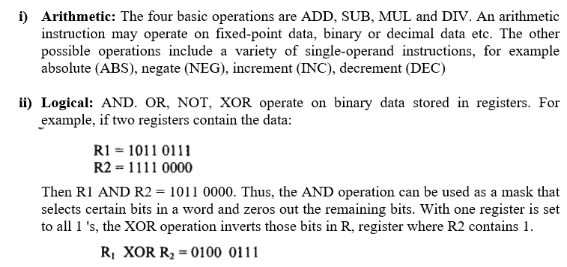
2. Data Processing instructions (Contd.)

Slide 29
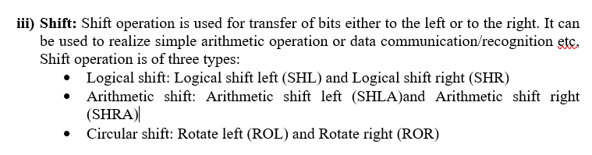
2. Data Processing instructions (Contd.)

Slide 30
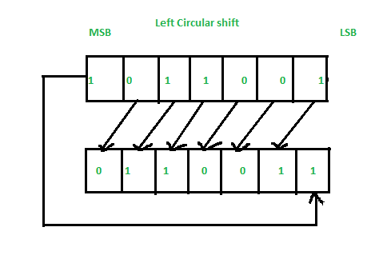
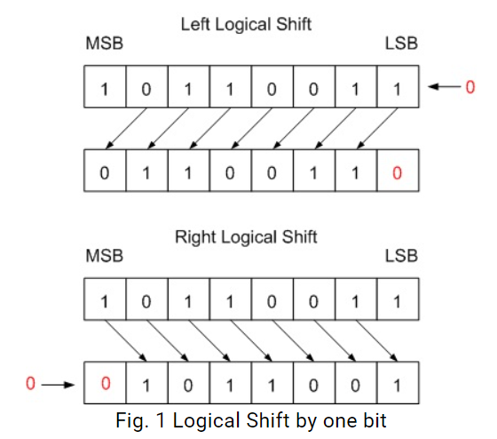
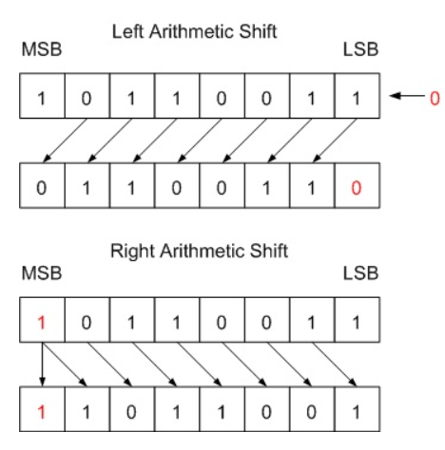
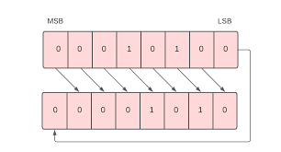
Logical shift operations

Slide 31
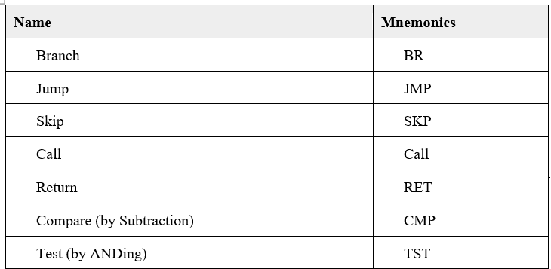
3. Program sequencing and control instructions
The program control instructions control the flow of program execution and are capable of branching to different program segments.

Slide 32
4. Miscellaneous Instructions
These instructions do not fit in any of the above categories.
Those instructions for I/O, interrupt, halt, timer setting, memory clearing, etc fall in this category.

Slide 33
1.9 Address Instruction Formats
An Instruction Format defines the layout of the bits of an instruction in terms of its constituent fields.
An Instruction must include an opcode and zero or more operands either implicitly or explicitly.
Four types:
Zero-Address instruction
One-Address instruction
Two-Address instruction
Three-Address instruction

Slide 34
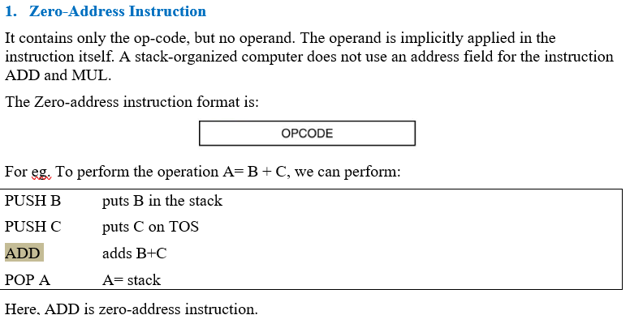

Slide 35
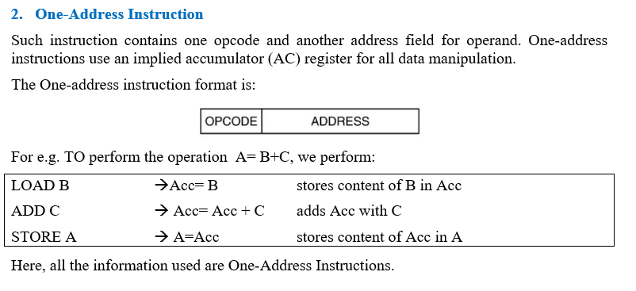

Slide 36
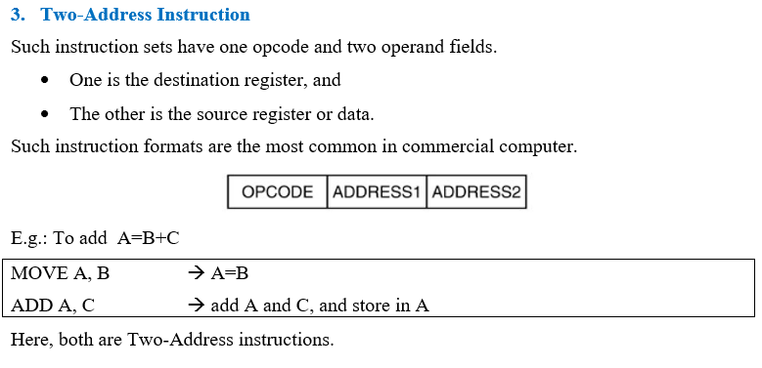

Slide 37
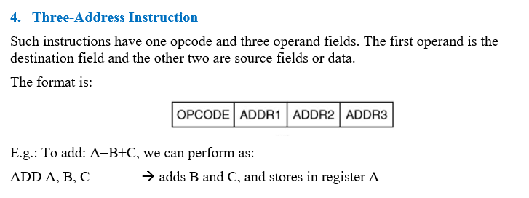

Slide 38
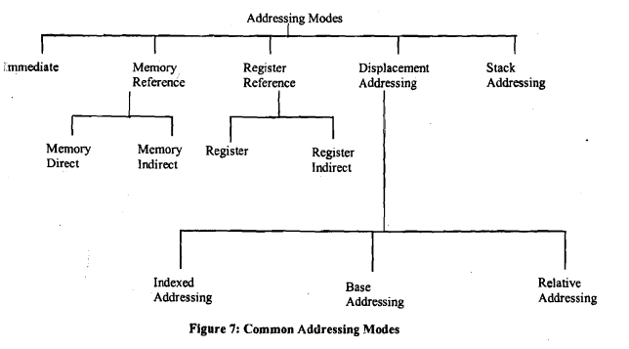
1.10 Addressing Modes
Addressing mode refers to the way of assigning the address of the operand in memory.

Slide 39
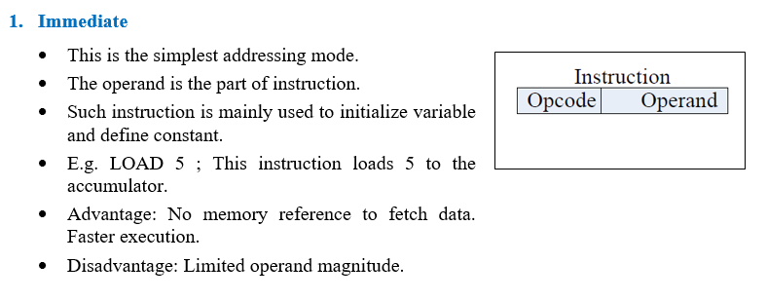

Slide 40
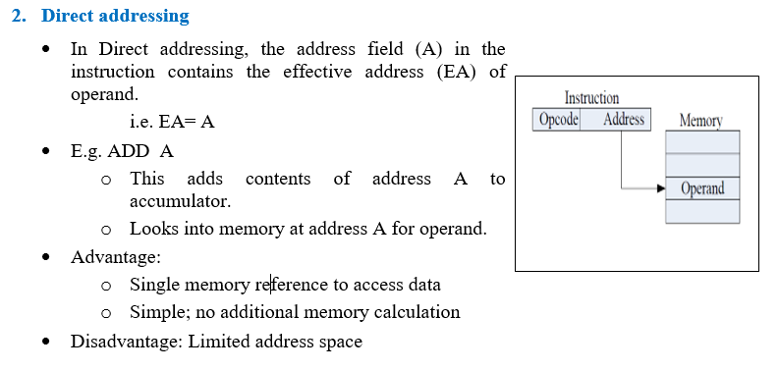

Slide 41
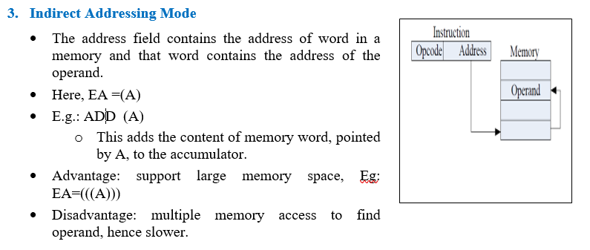

Slide 42
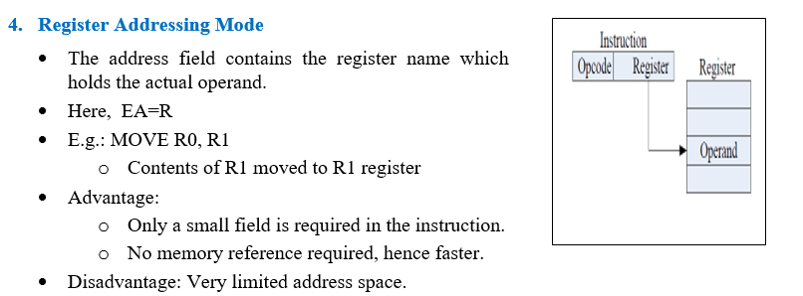
R0

Slide 43
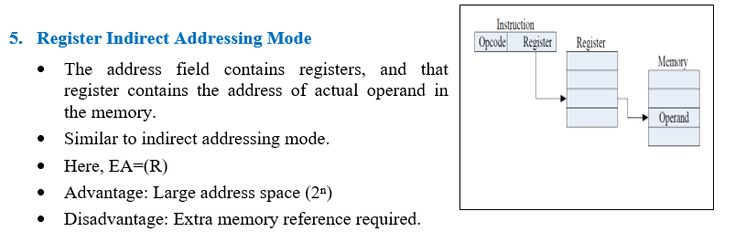

Slide 44
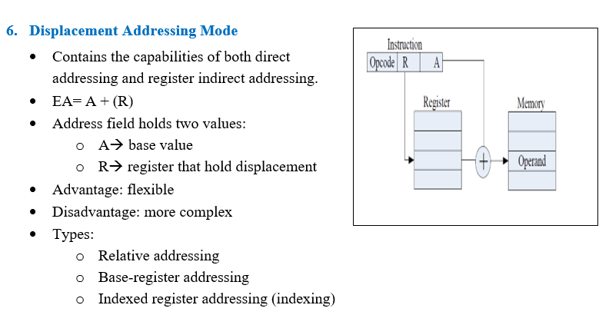

Slide 45
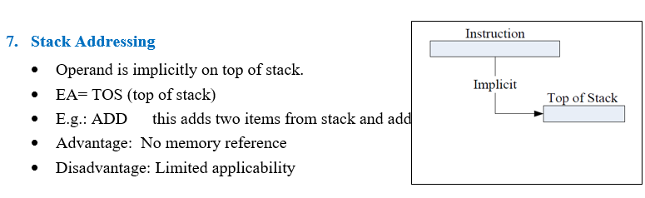

Slide 46
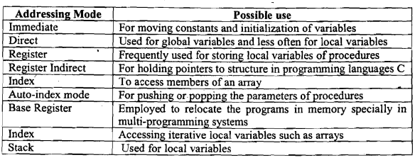
Summary

Slide 47
1.11 Design Issues for ISA
Operation repertoire: How many and which operations to provide, and how complex operations should be
Data types: The various types of data upon which operations are performed
Instruction format: Instruction length (in bits), number of addresses, size of various fields, and so on
Registers: Number of processor registers that can be referenced by instructions, and their use
Addressing: The mode or modes by which the address of an operand is specified

Slide 48
Assignment:
Show the code to perform the computation X=A+(B*C)+D using microprocessors that use the following instruction format.
Three-operand instructions
Two-operand instructions
One-operand instructions
Zero-operand instructions
What is ISA? Write down the factors to be considered while designing ISA.
Explain the Assembling and the Compiling process with block diagram.

Slide 49
Exam questions:
Describe the process of assembling the program in low level language. [PU 2017 Fall]
Describe in brief with an arbitrary illustration, how addressing modes works. [PU 2017 Spring]
Describe about ISA. What are the considerations to be made while ISA design? [PU 2018 Fall]
Describe the different types of addressing modes with illustration. [PU 2018 Spring]
Describe the different types of instruction formats. [PU 2019 Spring]
Explain different types of addressing modes used in computer system, along with their usages and application [PU 2020 Spring]

Slide 50
End of chapter 1

